Slide 1


Yiran Zhu 500593 | Jin Zou 500077 | Group 120
UK Street Crime
Analysis
Crime Type / Time / Location / Result & Suggestions
Notes:
Hello, we are from group 120.
We analyzed the British street crime data set during the past few weeks and made some notable discoveries. And today, we're honored to take this opportunity to share it.

Slide 2
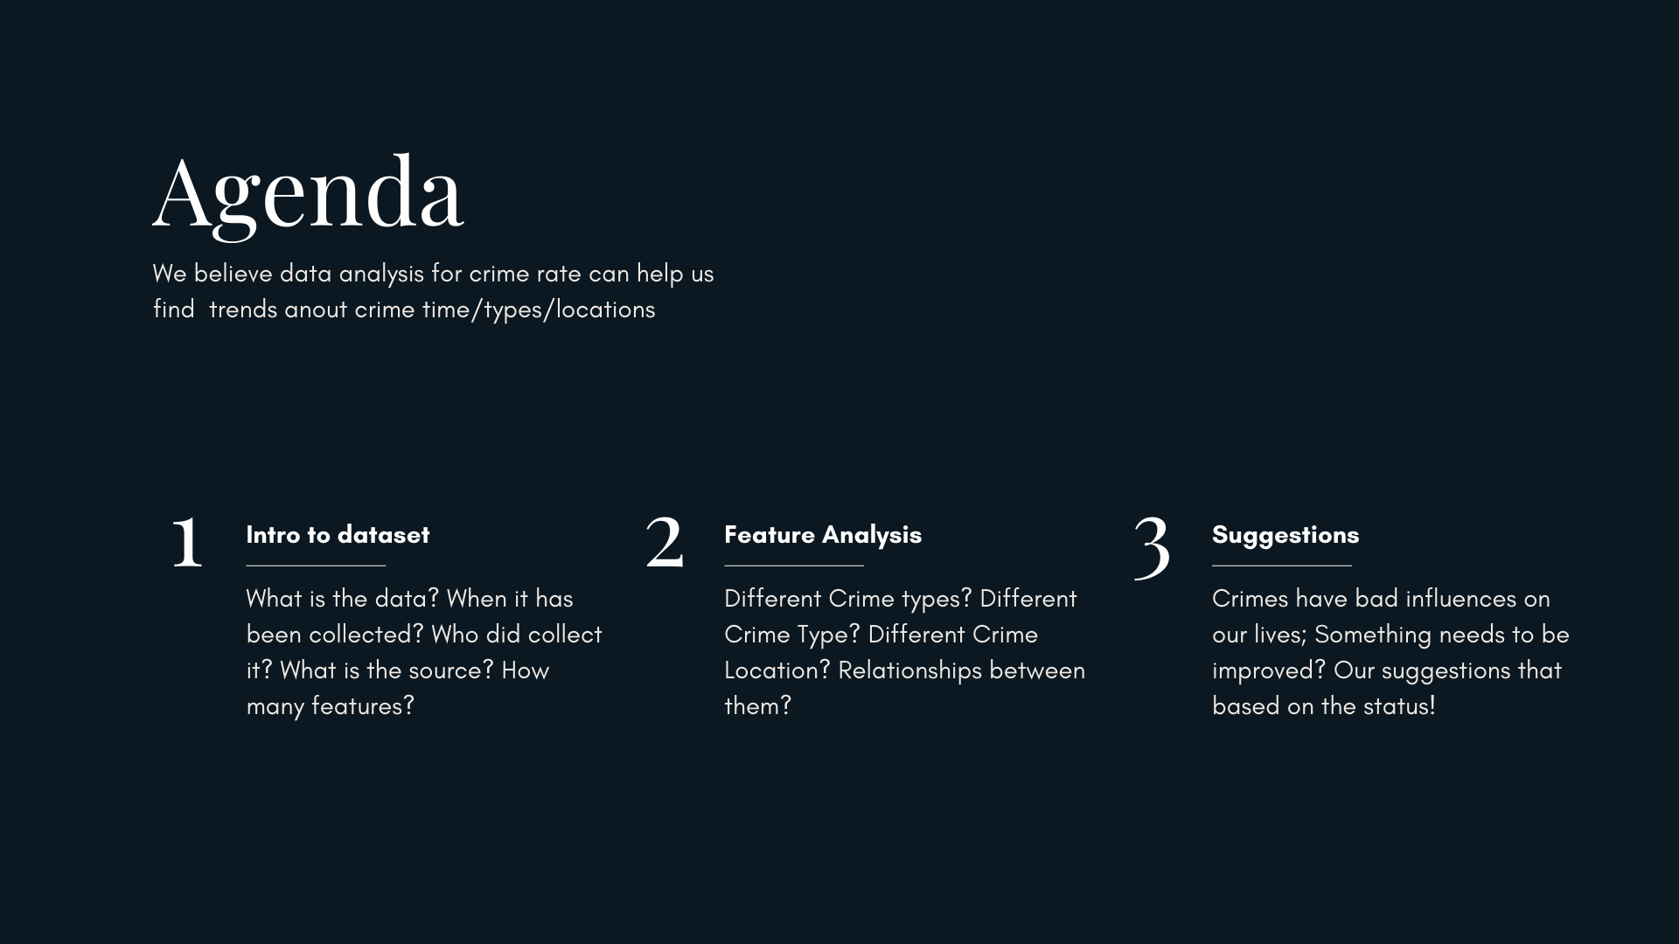
Notes:
Our topic will be divided into three parts:
data set introduction, data analysis, conclusion & suggestions. Let's start.

Slide 3
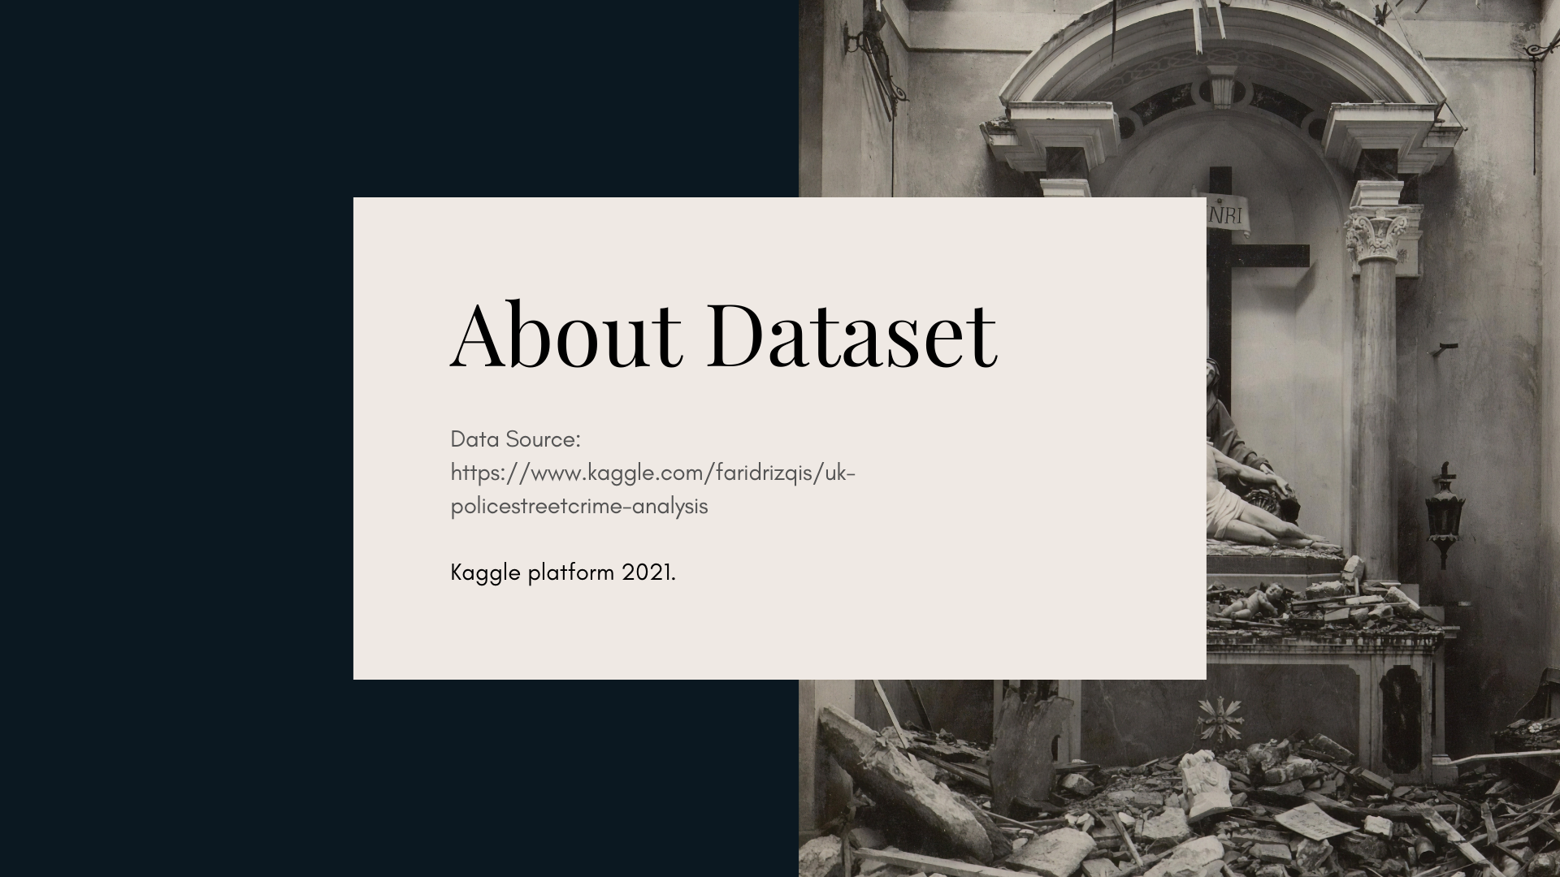
Notes:
First, about the data set.

Slide 4



UK street crime Dataset Between 2018.10-2021.09
Collected by
UK government
Kaggle platform
Attributes
ID, Year, Month,
Type, Outcome, etc.
Size
4.01GB, 12 columns
1,048,549 rows
Notes:
We downloaded this dataset from the Kaggle website. It is 4.01GB, contains 12 columns and 1048549 rows. Attributes include crime ID, year, month, place, crime types, etc..

Slide 5


Big Data
Tradition
Easy to manipulate
Enable for larger size
Excel, Spss: Unable to save
Python: Hard to manipulate
Notes:
Here, we get the data, and we couldn't help wondering what method we should use to manipulate it?
Should we use the traditional ways? Or should we use the bid data method?
The answer is obvious; we should use a big data solution.
As just mentioned, our data set is about 4GB, with traditional methods like excel or SPSS will cause data loss.
And for manipulating such as filter, directly uploading the data set in a python environment will be time-consuming.

Slide 6





Methods | Problems
Wordcount
– Summarize , pick attributes
#1 When ?
-Crime rate changes with years and months
#2 What ?
- Crime rate of different crime types
Join Tables
– Relations between attributes
#3 Where ?
- Locations where crimes occur most
Word Clouds | Matplotlib
– Visualize Results
#4 How ?
- Resolution of crime cases
Notes:
After that decision, we can further explore what method we should use and the problems we'd like to explore.
First, we decided to use Hadoop and MapReduce to summarize the single attributes, such as the total number of crimes that occurred at a specific time or location.
Second, we upload the filtered data into impala, join attributes based on the crime ID, explore the relations between attributes, such as crime type and occurred time.
Finally, we upload the result into Python and word cloud to help visualize.
We decided to explore the data from four aspects:
when: crime rate changes with years and months.
What: crime rate of different crime types.
Where: locations crimes occur most.
How: the resolution of the crime cases.

Slide 7
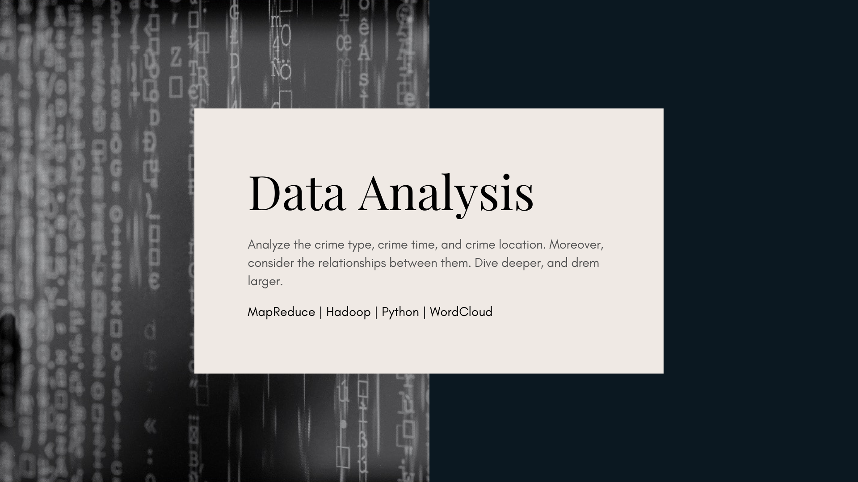
Notes:
After knowing about the dataset, let's start the analysis.

Slide 8
#1 When -Crime rate changes with years and months
* Years – Crime Rate getting Lower
* Months – 10 ~ 2 Lowest | 6 – 8 Highest
Notes:
First, the Crime rate changes with years and months.
This line chart shows the number of crime cases in different months and years. Orange, yellow, and white lines represent 2019, 2020, and 2021.
Based on the year, we can find from 2019-2021, the total amount of crime is getting lower, which is a good signal.
Based on the month, we can find that the highest number of crimes occurred from June to August, the middle of the year. Whereas the begin and end of the year are lowest.

Slide 9
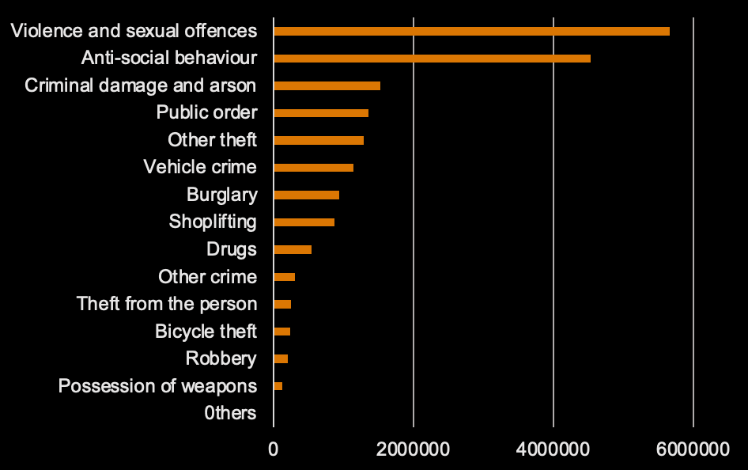
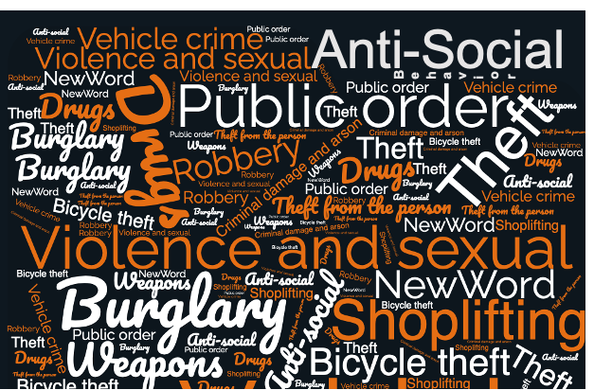
#2 What -Crime rate of different crime types
* Violence & sexual | Anti-crime happened most
* More then 5k Violence & sexual offences every day!

Slide 10
#2 What –Violence and sexual Crime
Even total amount of crime is decreasing
No DECREASE FOR VIOLENCE & SECUAL!
Notes:
As we discussed before, the total amount of crime decreased over the years—
however, the total amount of Violence and Sexual Crime appears to have a slight decrease from 2019 to 2020, then increase sharply from 2020 to 2021.

Slide 11
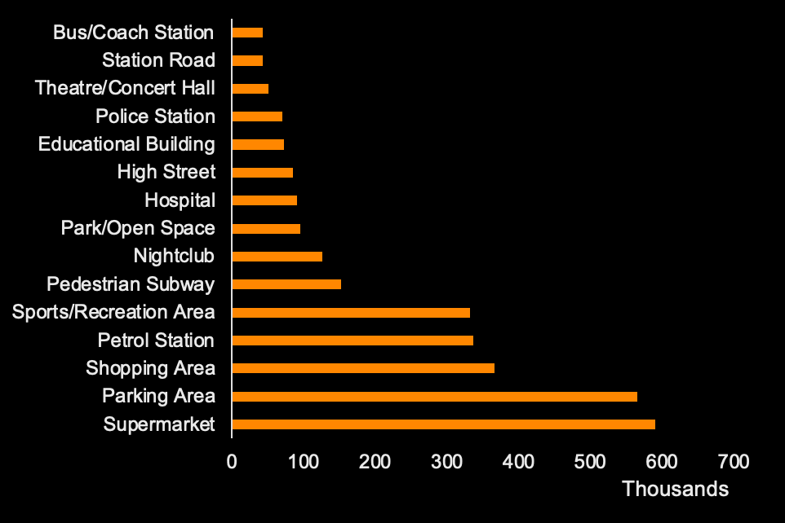
#3 Where - Locations where crimes occur most
* Supermarket, parking/shopping area tends to be the most dangerous places
* Violence & Sexual – nearly 1/3
Notes:
3, Locations where crimes occur most
We only selected the top 15 locations with the highest crimes in the past three years. From the bar chart on the left, the supermarket is where criminal activities occur most, with 600000 crimes in the past three years.
I'm also curious about the composition of these 600000 crimes. Do violence and sexual offenses and antisocial crimes account for the majority?
I hate to admit that violence and sexual crimes do account for one-third, antisocial crimes account for 20%.

Slide 12
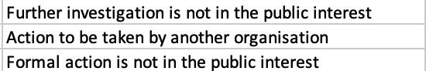
#4 How - Resolution of criminal incidents
* Most cases were solved (54%)
* About 40% were unable to be solved, mostly due to : Unable to prosecute suspect, Further investigation is not in the public interest.
Notes:
4. After studying so many heavy topics, let's finally look at the solution to the crimes.
Overall, the situation of crime settlement is good. More than half of the criminal cases were solved.
I also further explored why some cases are unsolved: mainly because the further investigation will affect the public interest, and other general organizations take over the issues. That makes sense.
All in all, the solution part is excellent.

Slide 13

Conclusion | Suggestion
Make a summary
Is our survey meaningful? Our suggestions!
Notes:
We have already finished the analysis. It's time to conclude.

Slide 14

Conclusion
#1
When - time
2019-2021, overall trend of crime rate – Descending
Nov. Dec. & Jan. - lowest crime rates
How - result
#2
What - type
Most criminal incidents have been properly handled
Violence and sexual - highest proportion
Then anti-social behavior
#3
Where - location
Supermarkets and parking lots
Violence & Sexual crimes account for 1/3
Notes:
In terms of time, the total crime rate decreased by year. June, July, and August have the highest crime rate.
In terms of types, violence and sexual crimes account for the highest proportion, followed by antisocial behavior crimes
In terms of location, supermarkets and parking lots are the most prone to crime. Violent crimes account for one-third of supermarket crimes.
The resolutions are good. Most criminal incidents have been appropriately handled. It is a good phenomenon.

Slide 15
Suggestions
#1
Violence & Sexual｜Anti-Social
#2
June - August
* Strengthen education and prevention, especially Violence & Sexual offence.
* Public organizations and schools - bring lectures on psychological counseling
* The number of police officers:
Increase -June to August
Cut - December to January
#3
Location
* More police officer
* Be attention on ourselves
Notes:
Finally, we Came to the most crucial part, our suggestions.
I believe you have the same feeling as me through the above analysis. Violence and sexual crime are significant problems we are facing now.
We should Strengthen the education and prevention of these two types of crimes, especially sexual offenses.
I also suggest public organizations and schools can increase lectures on psychological counseling.
Secondly, we can consider increasing the number of police officers from June to August and reducing the number from December to January to optimize government expenditure and obtain the best results at the same time.
Finally, I would like to emphasize that for the 15 most crime-prone areas listed in the article, strengthening police patrols is one thing. When we are in these locations, we also need to be vigilant.

Slide 16


Big Data, Better Life
Group 120 Yiran Zhu | Jin Zou | Dec. 10th, 2021
Notes:
The above is all we want to share today. I hope my analysis and application of big data technology can help us put forward constructive opinions and win a safer and happier life.

